Slide 1

DATA PROFESSIONALS SURVEY DATA ANALYSIS
By::: Kola Ademola

Slide 2
DATA PROFESSIONALS SURVEY DATA ANALYSIS
By::: Kola Ademola
ABOUT Data
PRESENTATION points:
The data for this project is a survey of data professionals and their happiness with various components of their job, their age, salary, country etc.… there was a total of 630 participants but after the data cleaning process, I was left with 575 total data points to use for the final analysis.
Disclaimer: Data was gotten from Alex Freberg. Link to Dataset..
Salary of the participants by their various roles.
Favorite programming languages further broken down by Job titles.
Average salary by gender.
Happiness of participants using 3 KPI’s
Management
Work / Life balance
Salary

Slide 3

DATA PROFESSIONALS SURVEY DATA ANALYSIS
Softwares: Python(Jupyter Notebook) & Power BI
I used Python to wrangle and clean the dataset, during this process I also did some feature engineering to add some columns necessary for this analysis.
After cleaning the data I moved it back to Power BI for final analysis and Visualization.

Slide 4
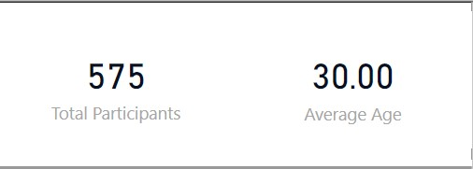
DATA PROFESSIONALS SURVEY DATA ANALYSIS
By::: Kola Ademola
There’s a total of 575 participants with an average age of 30

Slide 5
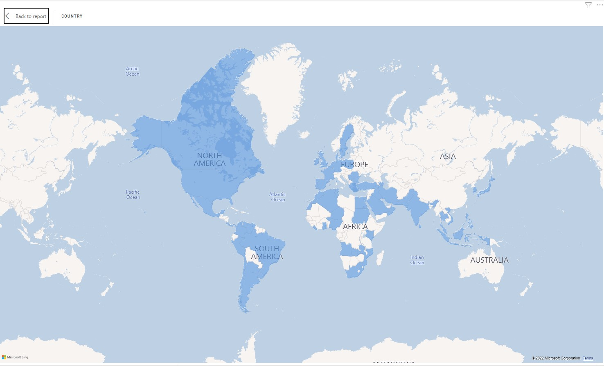
DATA PROFESSIONALS SURVEY DATA ANALYSIS
By::: Kola Ademola
The participants were spread out across various continents, but the majority of the participants were from North America.

Slide 6
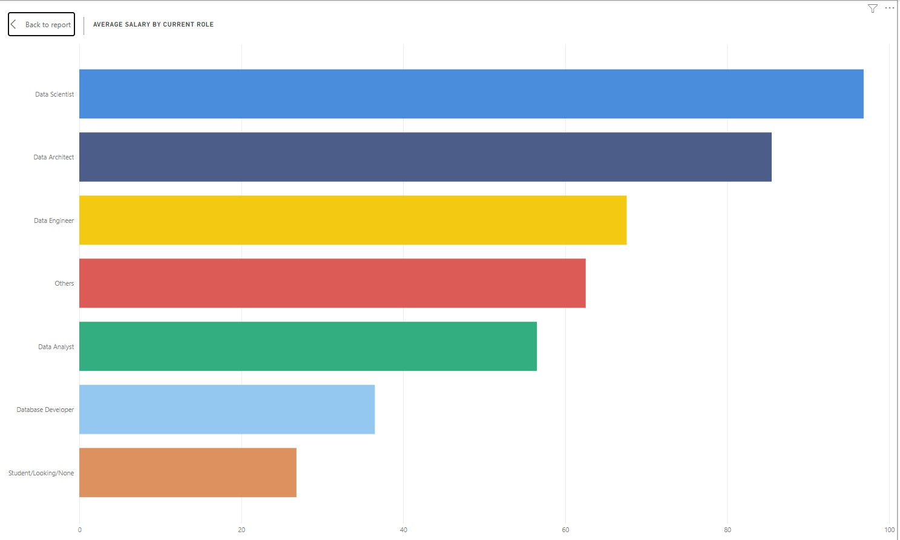
DATA PROFESSIONALS SURVEY DATA ANALYSIS
By::: Kola Ademola
Data Scientist were paid the most on average at almost $97k.

Slide 7
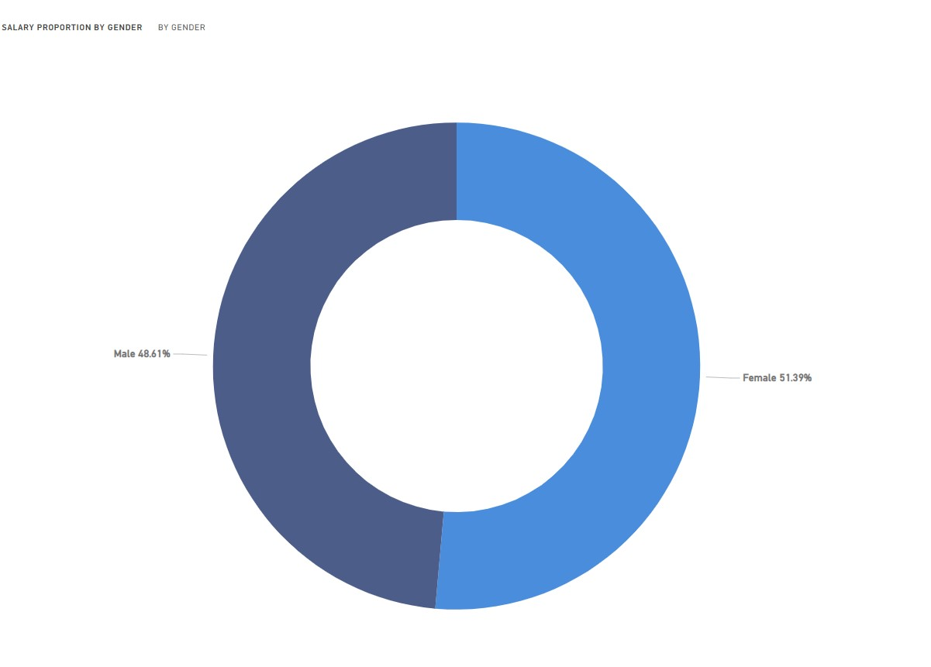
DATA PROFESSIONALS SURVEY DATA ANALYSIS
By::: Kola Ademola
Females were paid the most on average, but the difference isn’t too much from the pay of Males.

Slide 8
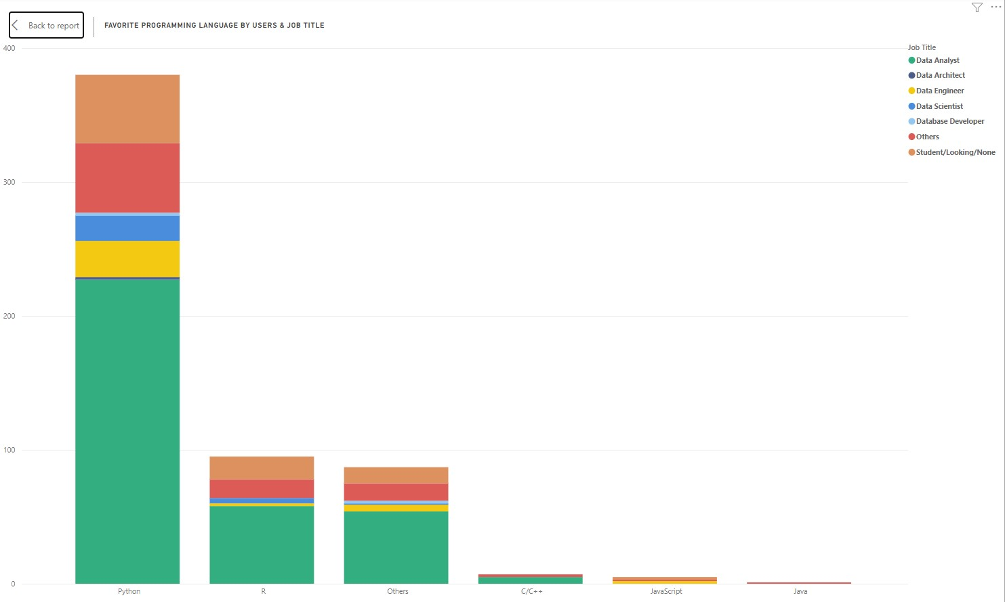
DATA PROFESSIONALS SURVEY DATA ANALYSIS
By::: Kola Ademola
Python is the favorite programming language used amongst the participants and its most common among the Data Analyst job titles.

Slide 9
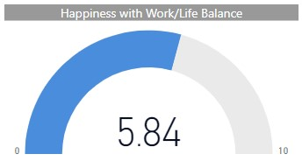
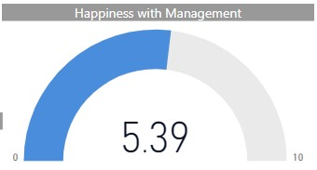
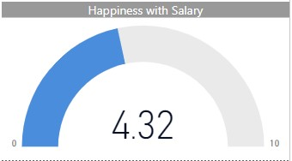
DATA PROFESSIONALS SURVEY DATA ANALYSIS
By::: Kola Ademola
The participants were most happy with their work & life balance when compared to salary and management, but generally on scale of 10 it’s just neutral.

Slide 10
Thank You.
Kola Ademola
FABRIKAM RESIDENCES
+234 806 517 447
kolaademola1561@yahoo.com
https://kola-ademola.github.io

